Slide 1


Part II
Center for Animal Disease Modeling and Surveillance (CADMS),
School of Veterinary Medicine, UC Davis
Jose Pablo Gomez, Jerome Baron, Jose Manuel Diaz Cao
Beatriz Martinez Lopez
Center for Animal Disease Modeling and Surveillance (CADMS)
Department of Medicine & Epidemiology
School of Veterinary Medicine
University of California, Davis
* Contact: jpgo@ucdavis.edu
https://cadms.vetmed.ucdavis.edu

Slide 2
Outline
Static vs Dynamic network analysis
Dynamic network statistics
Considerations and limitations
Notes:
What do we mean with dynamic network analysis
Difference between static and dynamic netowkrs
Dynamic network statistics
Considerations and limitations.

Slide 3
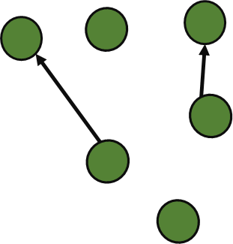
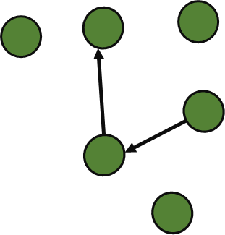
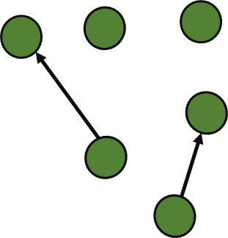
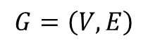
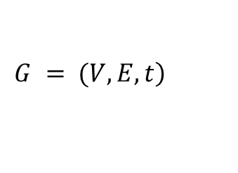
Whats the difference between Static and Dynamic analysis?
t 1-3
← Observation period
Static network
$$G=\left(V,E\right)$$
t 1
t 2
t 3
Dynamic network
$$\left.G = (V, E, t\right)$$
Network topology changes over time
Notes:
As we have seen on the previous lectures and excercises, we represent our network with a list of nodes and edges that we recorded over a timer period. Static Network analysis lacks the ability to model the changes in patterns over time, we assume that contacts are equaly likely to happen at any time.
In Dynamic netwok analysys...
Time is considered as another dimension of the graph
Nodes and edges are not constant over time (some nodes might only be active partially)

Slide 4
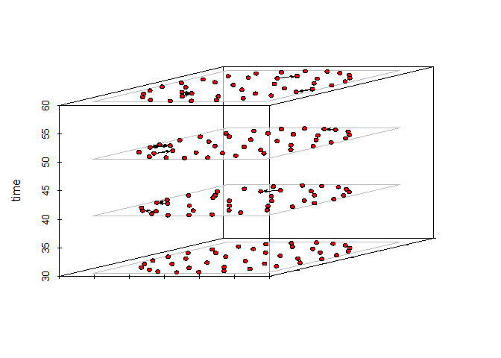
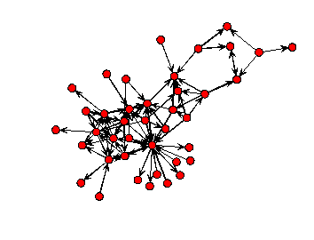
Why dynamic networks?
Notes:
A dynamic network (DN) can be seen as a collection off static networks aggregated at different time intervals.
Defining these intervals will depend on the information available and the results we are looking for.
Depending on the level of aggregation anywhere from all or none of the temporal information will be lost

Slide 5
Why is interesting in epidemiology?
Contact patterns are usually influenced by extrinsic events (weather conditions, demand, production cycles, etc..)
Disease transmission has a linear process.
A static network will always contain edges that were not necessarily present at the time when a transmission event occurred, which could be important for estimating the transmission rates.
Notes:
Contact patterns are usually influenced by extrinsic events (weather conditions, demand, production cycles, etc..) and these events might change over time.
Disease transmission has a linear process. We know that the disease will always be transmited from one individual to another
A static network will always contain edges that were not necessarily present at the time when a transmission event occurred, which could be important for estimating the transmission rates.

Slide 6
Network dynamics in epidemiology
Changes on the structure
Study disease transmission
T1
T2
T3
T1
T2
T3
Notes:
Two ways we can use network dynamics in epidemiology
First we will focus on using network dynamics for exploring changes on the structure.

Slide 7

DNA for Changes in the network structure
Understanding the evolution of the network over time:
As the environment changes, so does the social behavior of individuals.
T1
T2
T3
Understanding how changes in the environment impact the network structure:
Environmental changes such as drought, fires, floods, etc. can have an impact on the way individuals interact.
Event
T1
T2
Understanding how changes in individual traits impact the network structure:
Presence or absence of particular individuals can impact the structure of interactions.
T1
T2
T3
Notes:
Understanding the evolution of the network over time: As the environment changes, so odes the behavior of individuals. For example, we can use network dynamics to understand better how the animal trade changes over the lapse of a year, this might be helpful to identify seasonality of high movement, or we can also us this to evaluate how the reporting system has improved over the years.
Understanding how changes in the environment impact the network structure. Environmental changes such as drought, fires, floods, etc. can have an impact on the way individuals interact.
Understanding how changes in individual traits impact the network structure: Presence or absence of particular individuals can impact the structure of interactions. (for example when we remove nodes with high betweenness)

Slide 8
Network dynamics in epidemiology
Changes in the structure
Disease transmission
T1
T2
T3
T1
T2
T3
Notes:
Model or understand an observed epidemic
Making predictions about susceptibility of a population

Slide 9
Understand an observed epidemic
Static
T1
T2
T3
Infected
A
A
A
New Infected
E
E
E
Susceptible
D
B
D
B
D
B
C
C
C
1/1 new case
1/2 new case
1/1 new case
3/4 new cases = 75%
Dynamic
A
A
A
D
B
D
B
D
B
C
C
C
1/1 new case
1/1 new case
1/1 new case
3/3 new cases = 100%
Notes:
When estimating disease incidence, we usually have case and population data. In this example we have 5 individuals.
At T1 we ca
Static networks will always contain edges that were not necessarily present at the time the transmission events actually occurred.

Slide 10
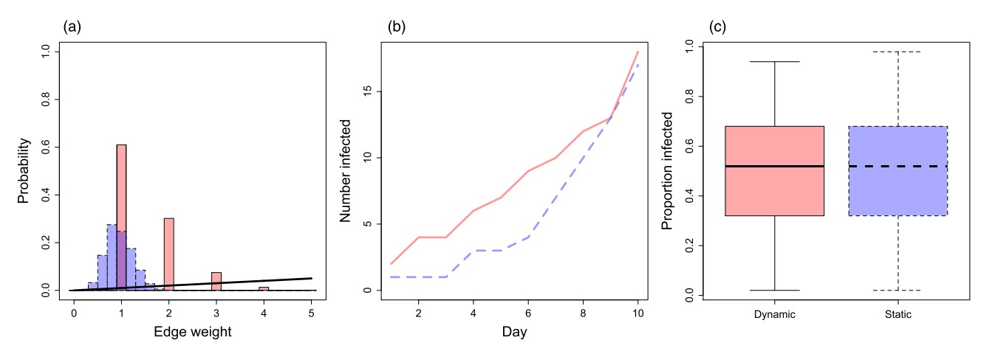
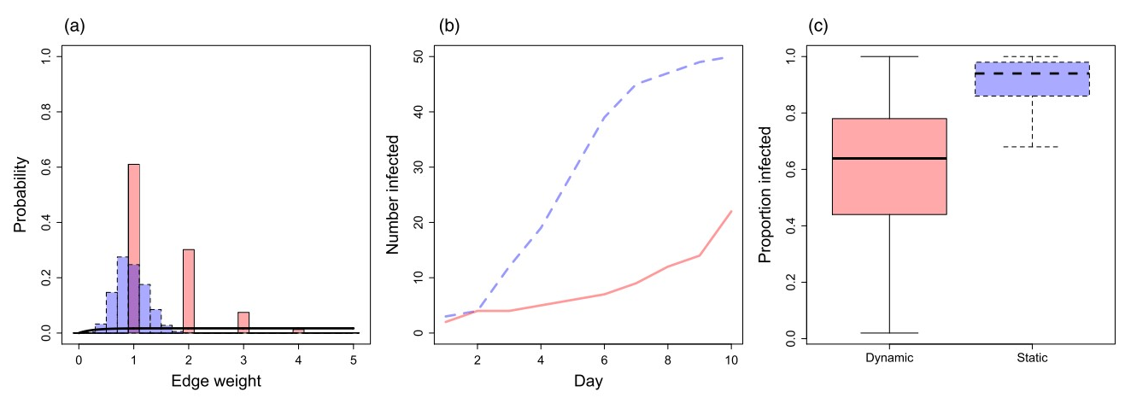
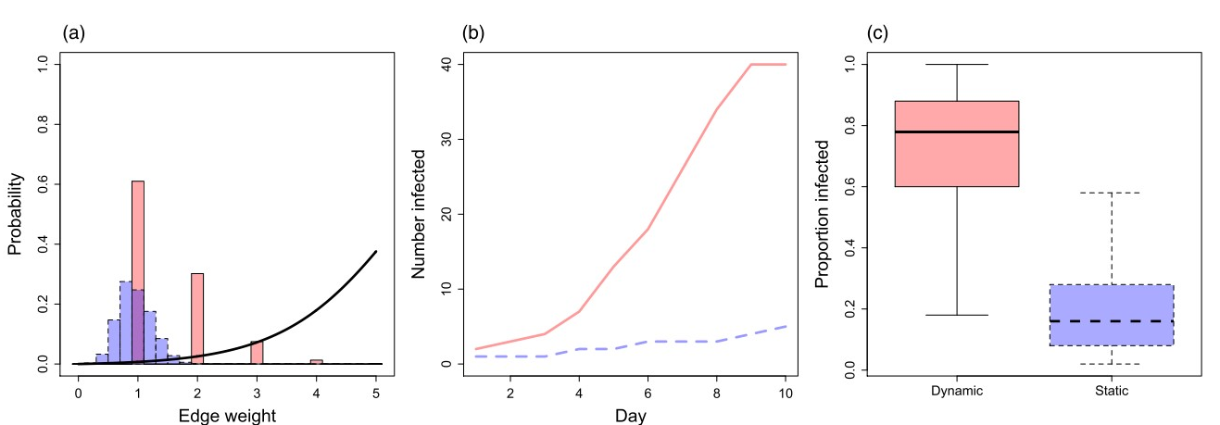
Making general predictions
A well designed study that uses DN at a temporal scale that matches the epidemic transmission profile will generate the most accurate conclusions.
Linear function
Decelerating function
Accelerating function
Transmission rate x Contact strength =
Damien 2017

Slide 11
Making general predictions
When the goal of modelling is to make general predictions such as the epidemic size rather than the pathway it takes, SN is often a better representation of the average population
Is the observed dynamic network likely to re-occur?
Same order of contacts?
Same period of time between contacts?
Notes:
When the goal of modelling is to make general predictions such as the epidemic size rather than the pathway it takes, SN is often a better representation of the average population
DN is generally relevant only to the time period when the population was observed. This might reduce the generality of the predictions.

Slide 12
Other things to consider
Is there enough data available to construct each of the temporal snapshots of the network?
Equal sampling efforts during the study period?
Notes:
It can be problematic to compare differently sized networks. I.e, if the population in time period 1 is larger than the population in time period 2, we expect that individuals ill have lower degree in the smaller network.

Slide 13
Dynamic Network Statistics

Slide 14
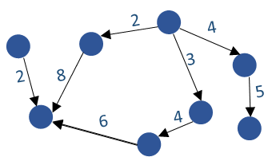
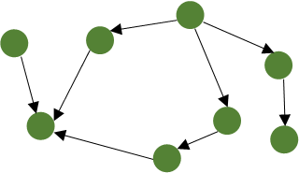
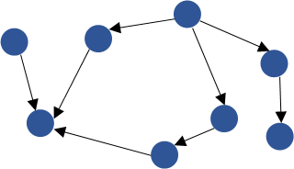
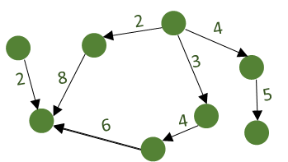
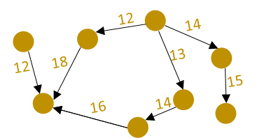
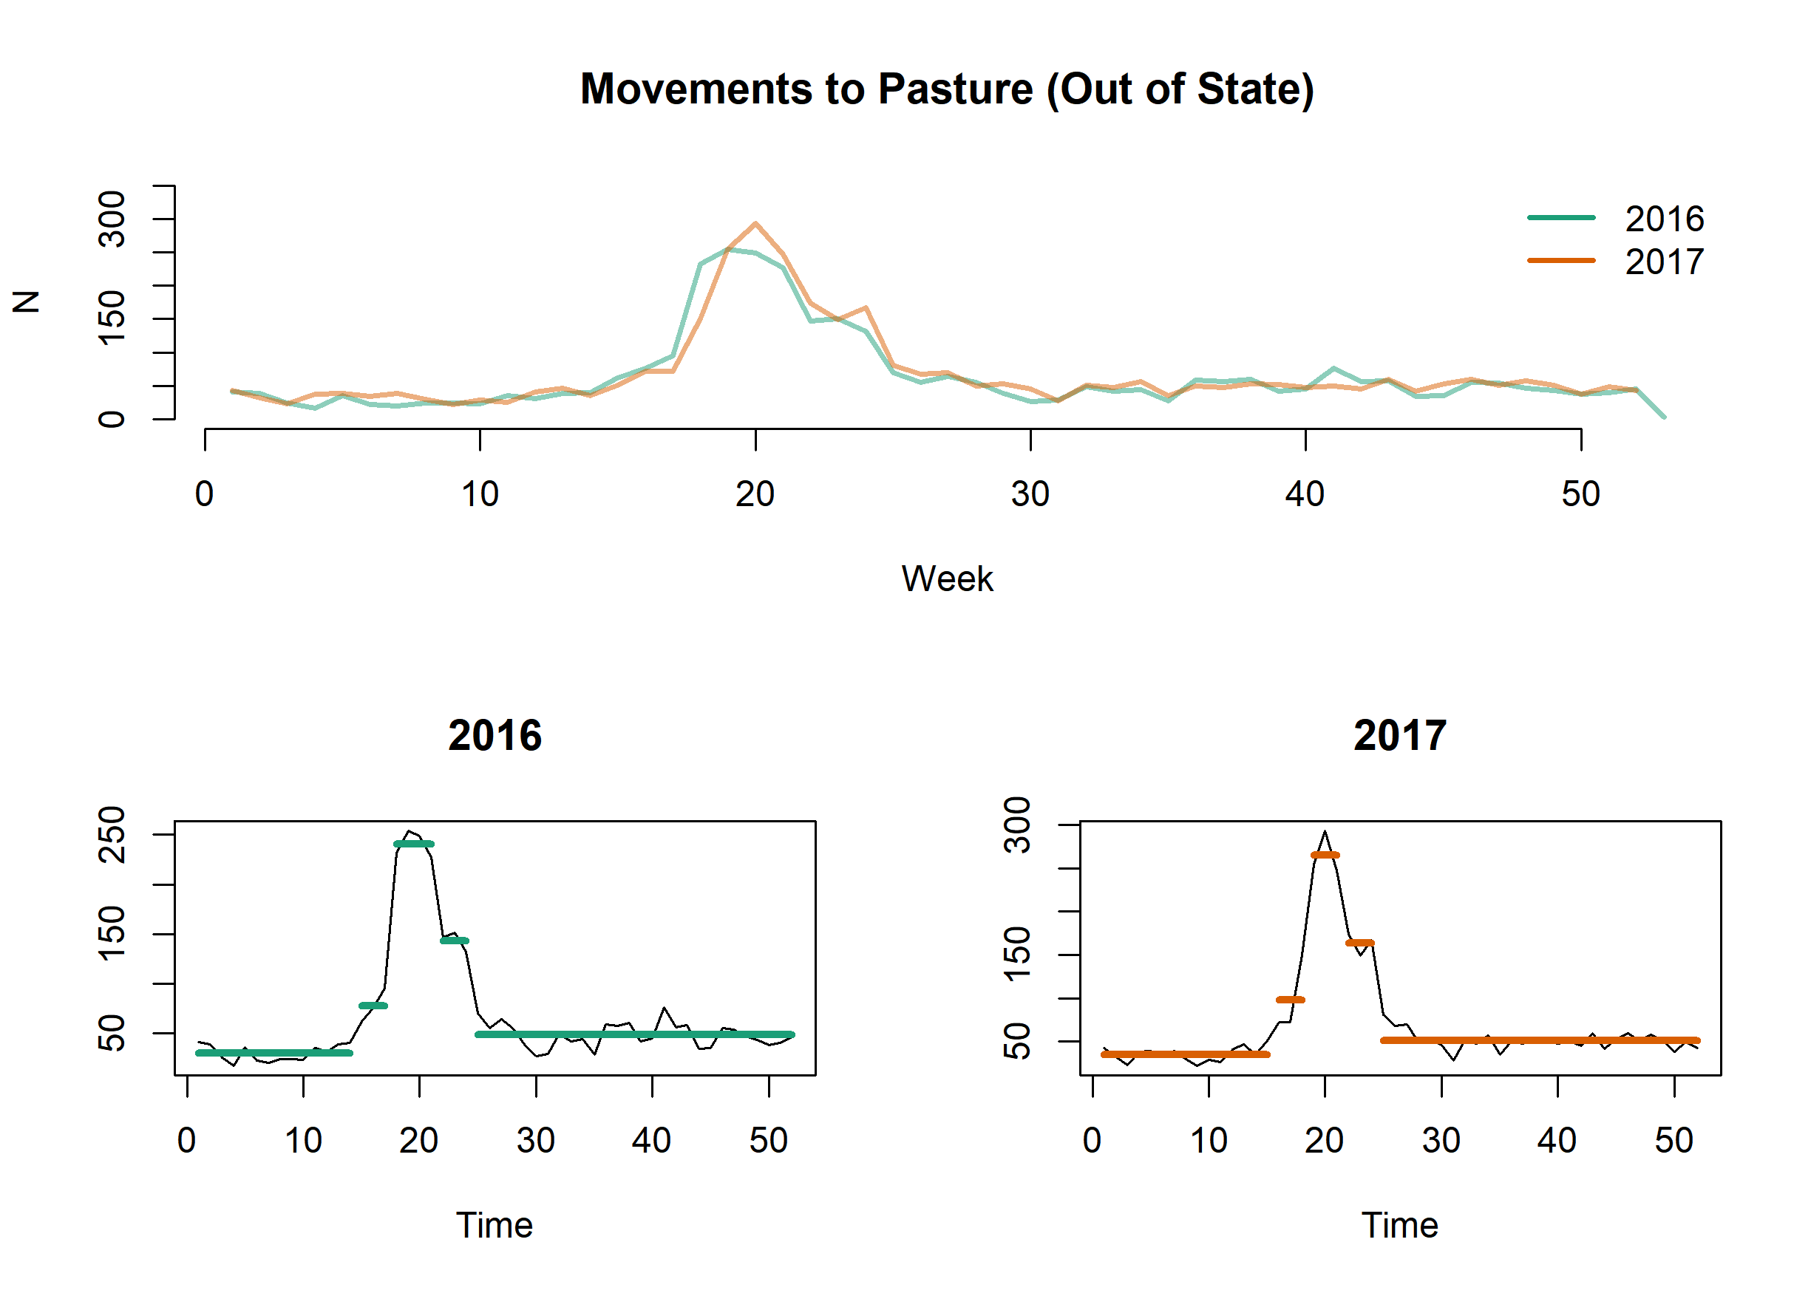
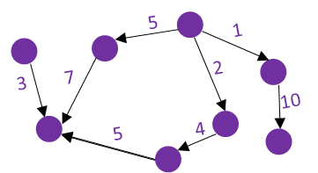
How do we know if a network is likely to re-occur?
Network isomorphism
Identify patterns
Same adjacency structure
Strictly isomorphic
Temporally isomorphic
Temporal order isomorphic
Notes:
In static network analysis, two networks are isomorphic if they have the same adjacency structure
For dynamic networks we can have:
Strictly isomorphic, same contacts at exactly same time.
Temporally isomorphic, same adjacency shifted by a constant amount of time
Temporal order isomorphic, same order of contacts

Slide 15
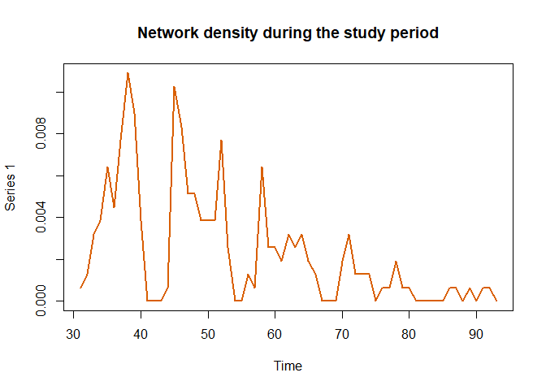
Why Dynamic network analysis?
Centrality measures and network statistics used in static networks can be adapted for dynamic network analysis.
Notes:
I.e Instead of having an overall network density, we can have a time series of the network density at each interval, allowing to identify critical points of network activity.

Slide 16
Temporally reachable sets
Temporally reachable sets
5
5
10
10
The temporally reachable set of a node, represents the set of other nodes that can be reached following a temporal path.
Notes:
If we look at this two networks we might conclude that they are exactly the same, but when we add temporal information, we might notice that the order of the contacts is different

Slide 17
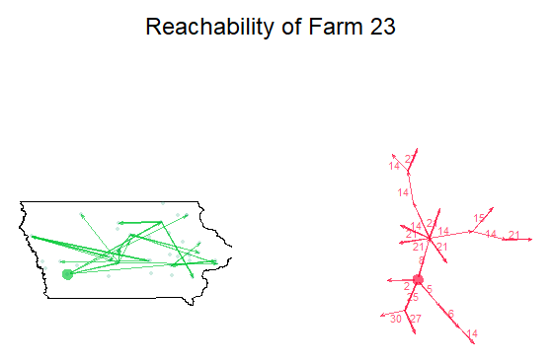
Temporally reachable sets
3
5
5
2
3
3
30

Slide 18
Recap
Damien 2017
Yes
Dynamic networks recommended
Are there any predictable patterns in the network dynamics?
Is the temporal resolution of the data similar in the network?
The temporal data is high resolution?
Yes
Yes
No
Static networks recommended
No
No
Static Network recommended
Static networks recommended
Notes:
Independent data such as: the timing of infection or changes in individual state

Slide 19
Limitations
Time resolution will have an impact on our analysis
When using dynamic network analysis for modeling or prediction we have to consider how likely is that the observed network will happen again.
Implementing DN adds complexity to the model, can reduce generality and overinflate the perceived quality of predictions.

Slide 20
Questions?
Notes:
When the aim of the modelling is to make general predictions such as the size of an outbreak rather than the specific pathways it takes, static networks are often better representations of an average population. Simulating an outbreak on an observed dynamic network might reduce the generality of the predictions. Are the dynamics repeatable? Observed dynamic networks are only informative if they are likely to re-occour
Dynamic networks are more important quantifying observed epidemic events
Static networks might be more useful for making predictions about the outcome of an epidemic at some unknown time in the future
Notions of connectedness, which have been important in the study of static networks, must be defined with respect to some time bound.
A popular way to describe paths in a temporal network is using time-respecting paths. Sequence of contacts that connect the starting and ending nodes with each contact in the path coming after the one before time.
It also important to consider that most diseases are likely to result in changes of behavior, and therefore potentially impact the network dynamics.
For example, a sick individual for a given disease might be less likely to be interacting with other individuals, compared to a healthy individual.
For example, node B is reachable from A only if there is a time respecting path from A to B

Slide 21
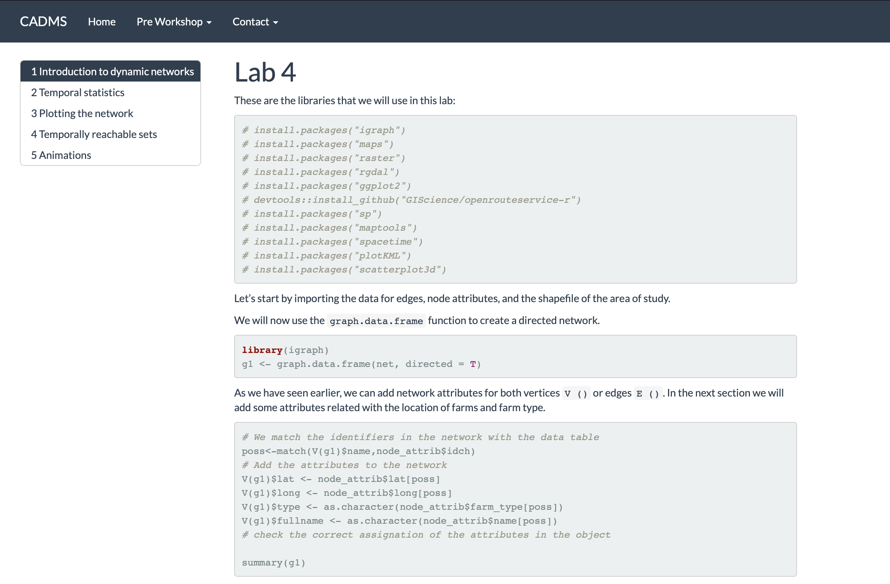
Time for Lab 4!
Notes:
When the aim of the modelling is to make general predictions such as the size of an outbreak rather than the specific pathways it takes, static networks are often better representations of an average population. Simulating an outbreak on an observed dynamic network might reduce the generality of the predictions. Are the dynamics repeatable? Observed dynamic networks are only informative if they are likely to re-occour
Dynamic networks are more important quantifying observed epidemic events
Static networks might be more useful for making predictions about the outcome of an epidemic at some unknown time in the future
Notions of connectedness, which have been important in the study of static networks, must be defined with respect to some time bound.
A popular way to describe paths in a temporal network is using time-respecting paths. Sequence of contacts that connect the starting and ending nodes with each contact in the path coming after the one before time.
It also important to consider that most diseases are likely to result in changes of behavior, and therefore potentially impact the network dynamics.
For example, a sick individual for a given disease might be less likely to be interacting with other individuals, compared to a healthy individual.
For example, node B is reachable from A only if there is a time respecting path from A to B

Slide 22
Further applications
Center for Animal Disease Modeling and Surveillance (CADMS),
School of Veterinary Medicine, UC Davis
Jose Pablo Gomez*, Jerome Baron,
Beatriz Martinez-Lopez
Center for Animal Disease Modeling and Surveillance (CADMS)
Department of Medicine & Epidemiology
School of Veterinary Medicine
University of California, Davis
* Presenter: Email: jpgo@ucdavis.edu
https://cadms.vetmed.ucdavis.edu

Slide 23
Outline
Statistical Models
Simulation Models
Notes:
In this last part we will talk briefly about some applications of the information we obtain from our network analysis and explain a couple of methodologies that can be used.

Slide 24
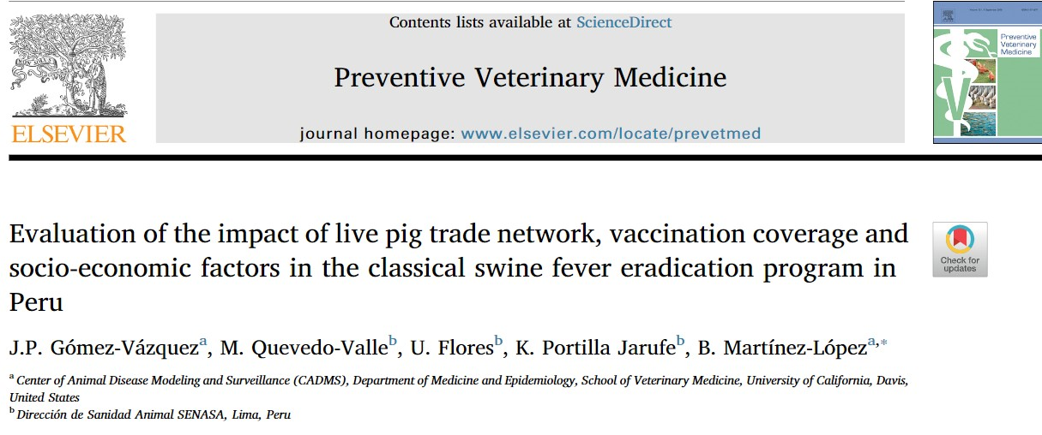
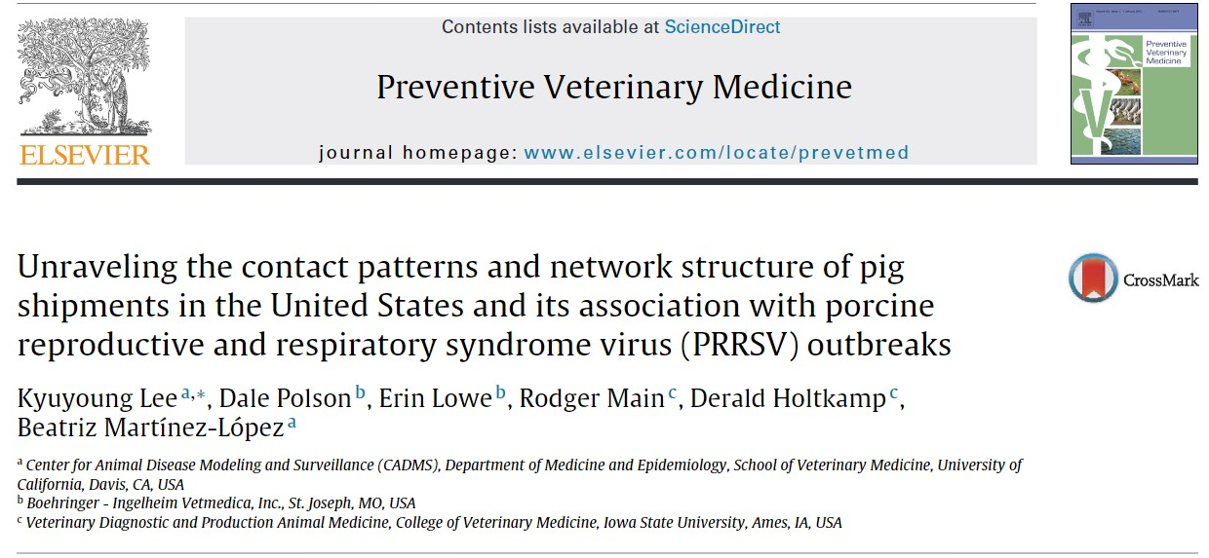
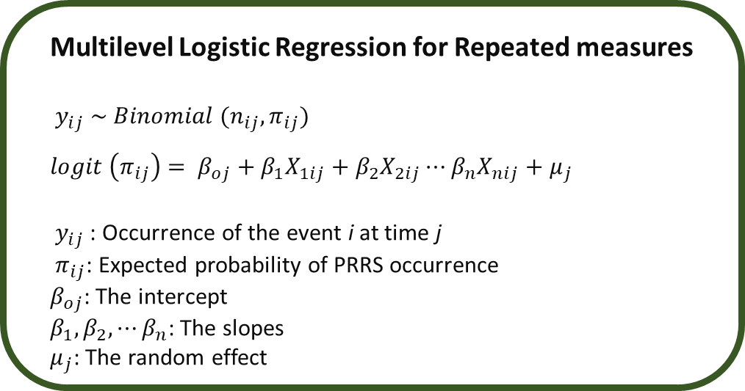
Network Analysis and Regression
Regression assumptions:
Linearity
Independence
Normality
Equal variance
SNA recognize the influence of community members on each other.
i.i.d
Multilevel Logistic Regression for Repeated measures
$y_{ij} \sim Binomial (n_{ij},π_{ij})$
$logit \left(π_{ij}\right)$ $= β_{oj}+β_{1}X_{1ij}+β_{2}X_{2ij}⋯β_{n}X_{nij}+μ_{j}$
$y_{ij}$: Occurrence of the event i at time j
$π_{ij}$: Expected probability of PRRS occurrence
$β_{oj}$: The intercept
$β_{1}, β_{2}, ⋯β_{n}$: The slopes
$μ_{j}$: The random effect
Notes:
A lot of you might be familiarized with regression models, and as you might know is a popular way to din inference and prediction. We just have to remember that regression has a set of assumptions that include: LINE = Independent Identically Distributed
SNA basically tell us that the individuals in a network will have an influence in each other, which pretty much tell us that i.i.d. doesn't really exists
One way to deal with this is using mixed effects regression, which allows to include a random effect. The random effect in regression models

Slide 25
ERGMs
Exponential Random Graph Models: Predicting dichotomous ties. What is the probability of observing our network?
Evaluate a cross sectional structure
Network structure: If Farm A contacts Farm B, and Farm B contacts Farm A, what are the chances of farm A contacting Farm B? (Triangles formations)
Individual covariates: are sow farms more likely to contact GDUs?
A
B
A
B
D
C
C
ergm https://www.jstatsoft.org/article/view/v024i03
Notes:
Another statistical model that is very similar to regression are the ERGMs. Which stands for Exponential....
ERGMs basically predicts how likely is that two pair of nodes will be conencted and how likely is to observe our network.
On ERGMs we can add:
Individual level covariates, such as type of farm. In this example we have an observed tie between A -> B, in a very simplified way, our model can compute, given we observe this contacts how likely is that Node A contacts C or D based on the type of farm
Network structure covariates:

Slide 26
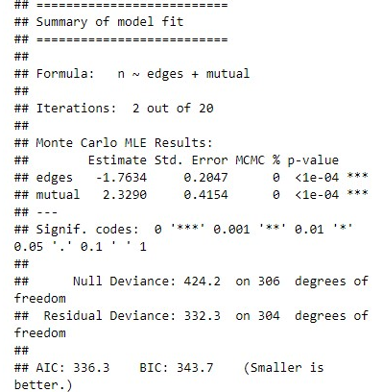
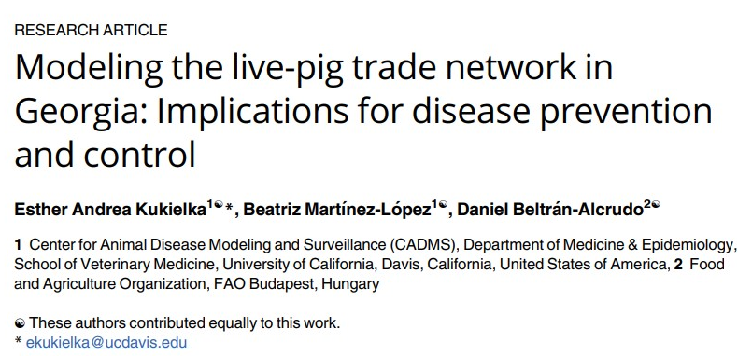

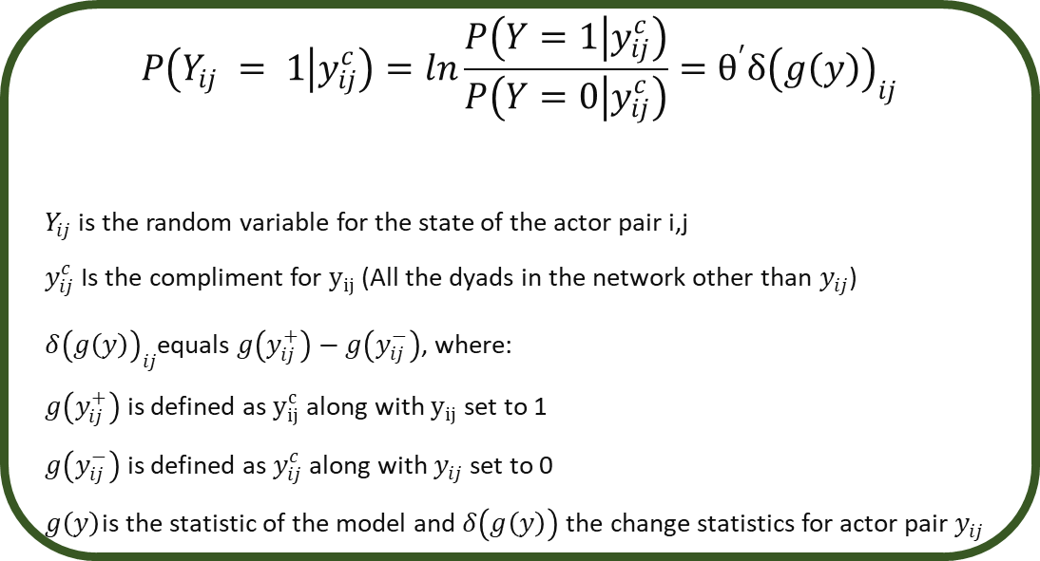
Exponential Random Graph Models
$$P\left(Y_{ij} = 1 | y_{ij}^{c}\right)=ln\frac{P\left(Y=1 | y_{ij}^{c}\right)}{P\left(Y=0 | y_{ij}^{c}\right)}=θ^{′}δ{\left(g\left(y\right)\right)}_{ij}$$
$Y_{ij}$is the random variable for the state of the actor pair i,j
$y_{ij}^{c}$Is the compliment for $y_{ij}$ (All the dyads in the network other than $y_{ij}$)
$δ{\left(g\left(y\right)\right)}_{ij}$equals $g\left(y_{ij}^{+}\right)−g\left(y_{ij}^{−}\right)$, where:
$g\left(y_{ij}^{+}\right)$ is defined as $y_{ij}^{c}$ along with $y_{ij}$ set to 1
$g\left(y_{ij}^{−}\right)$ is defined as $y_{ij}^{c}$ along with $y_{ij}$ set to 0
$g\left(y\right)$is the statistic of the model and $δ\left(g\left(y\right)\right)$ the change statistics for actor pair $y_{ij}$
Notes:
ERGMS are very similar to regression in the aspect that we have a conditional probability as our outcome, and we use a function to estimate that.
So in R the results looks very similar to regression where we will have the coefficients, SE and p-values and even AIC and BIC.
ERGMs are also used to obtain more generalizable networks and for some modeling frameworks is used as a first step to inform the model

Slide 27
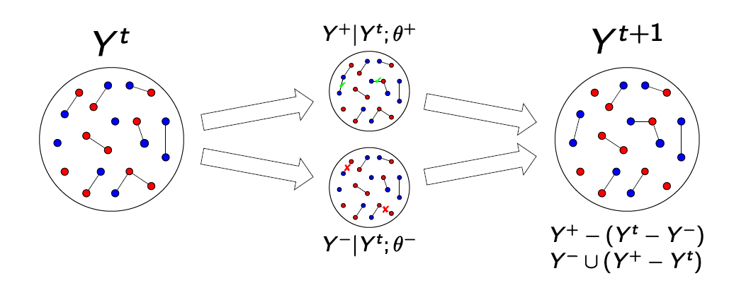
STERGMs
Separable Temporal ERGM
Y⁺ = network in the formation process after evolution
Y⁻ = network in the dissolution process after evolution
This is the origin of the “S” in STERGM

Slide 28
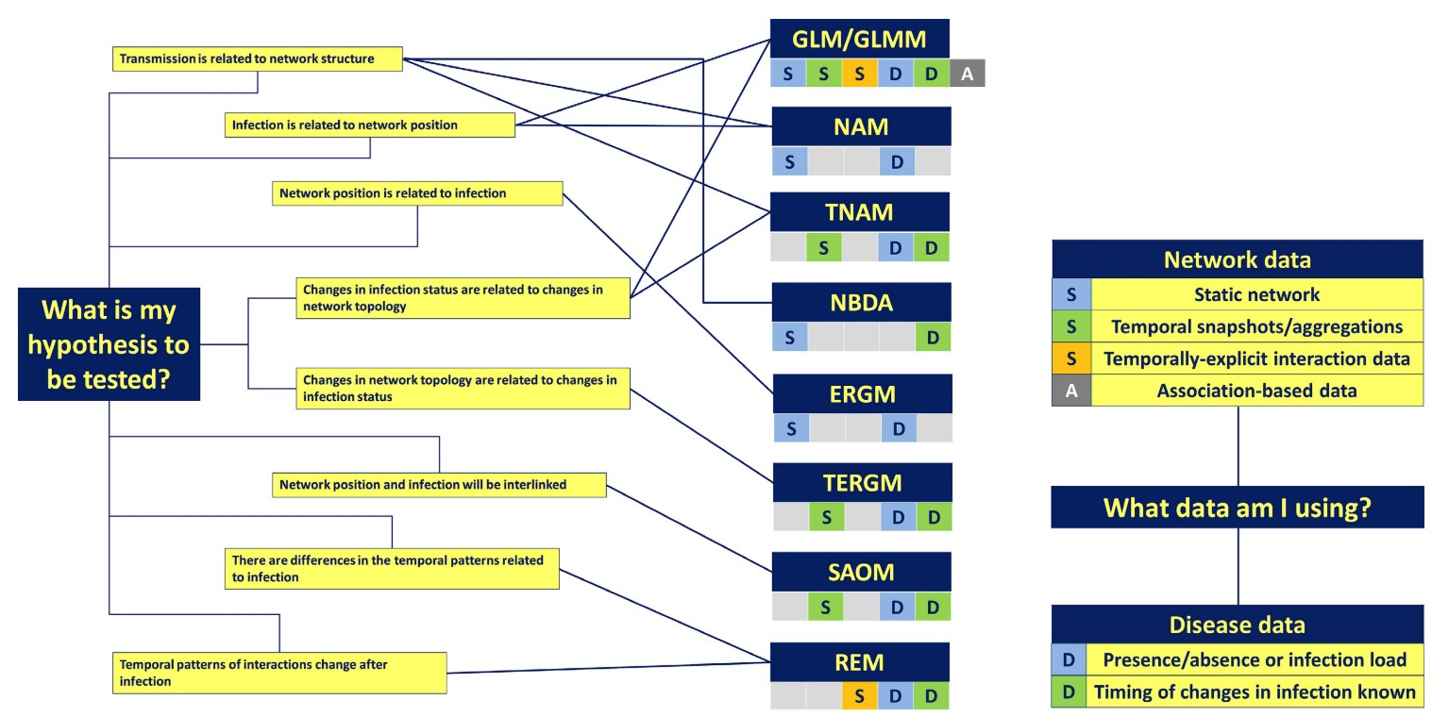
Statistical Models inNetwork Analysis
GLM Generalized linear model
GLMM Generalized linear mixed model
NAM Network autocorrelated model
TNAM temporal autocorrelated model
ERGM exponential random graph model
NBDA Network based diffusion analysis
SAOM stochastic actor-oriented model
TERGM Temporal ERGM
REM Relational events model
Matthew J. Silk 2017
Notes:
Independent Identically Distributed

Slide 29
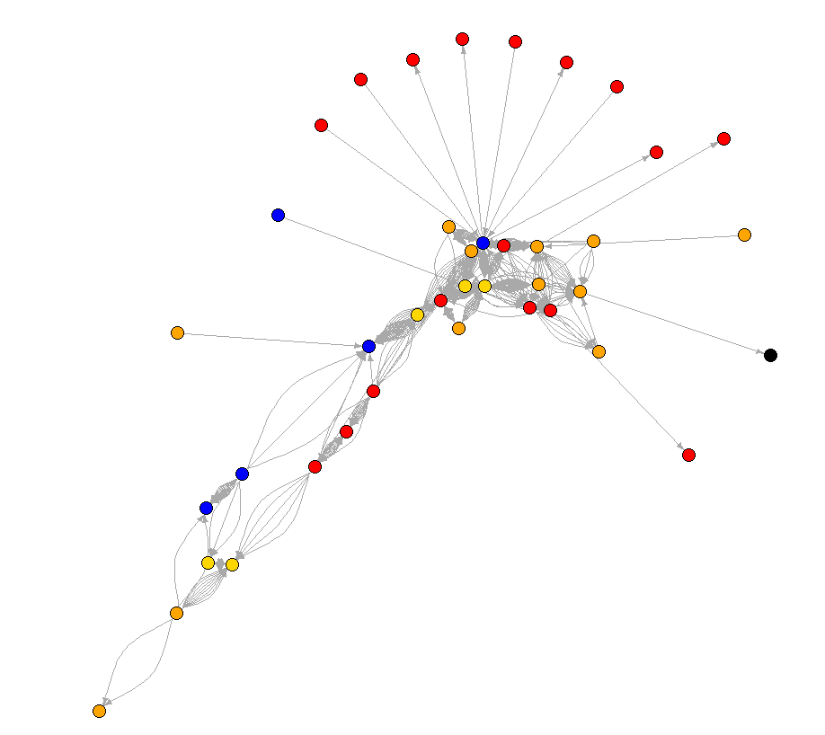
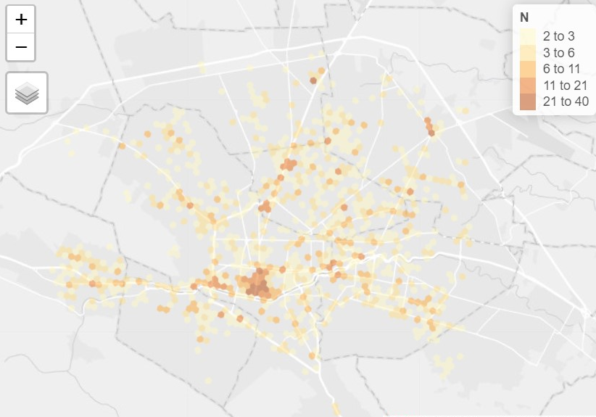
Disease spread models
Most epidemic models incorporate homogenous mixing assumption (Law of mass action).
This for some scenarios this assumption is unrealistic but simplifies the mathematical computation of the model.
Populations are not homogenously mixed, population structure can arise from spatial and social interactions.
β
γ
S
I
R

Slide 30
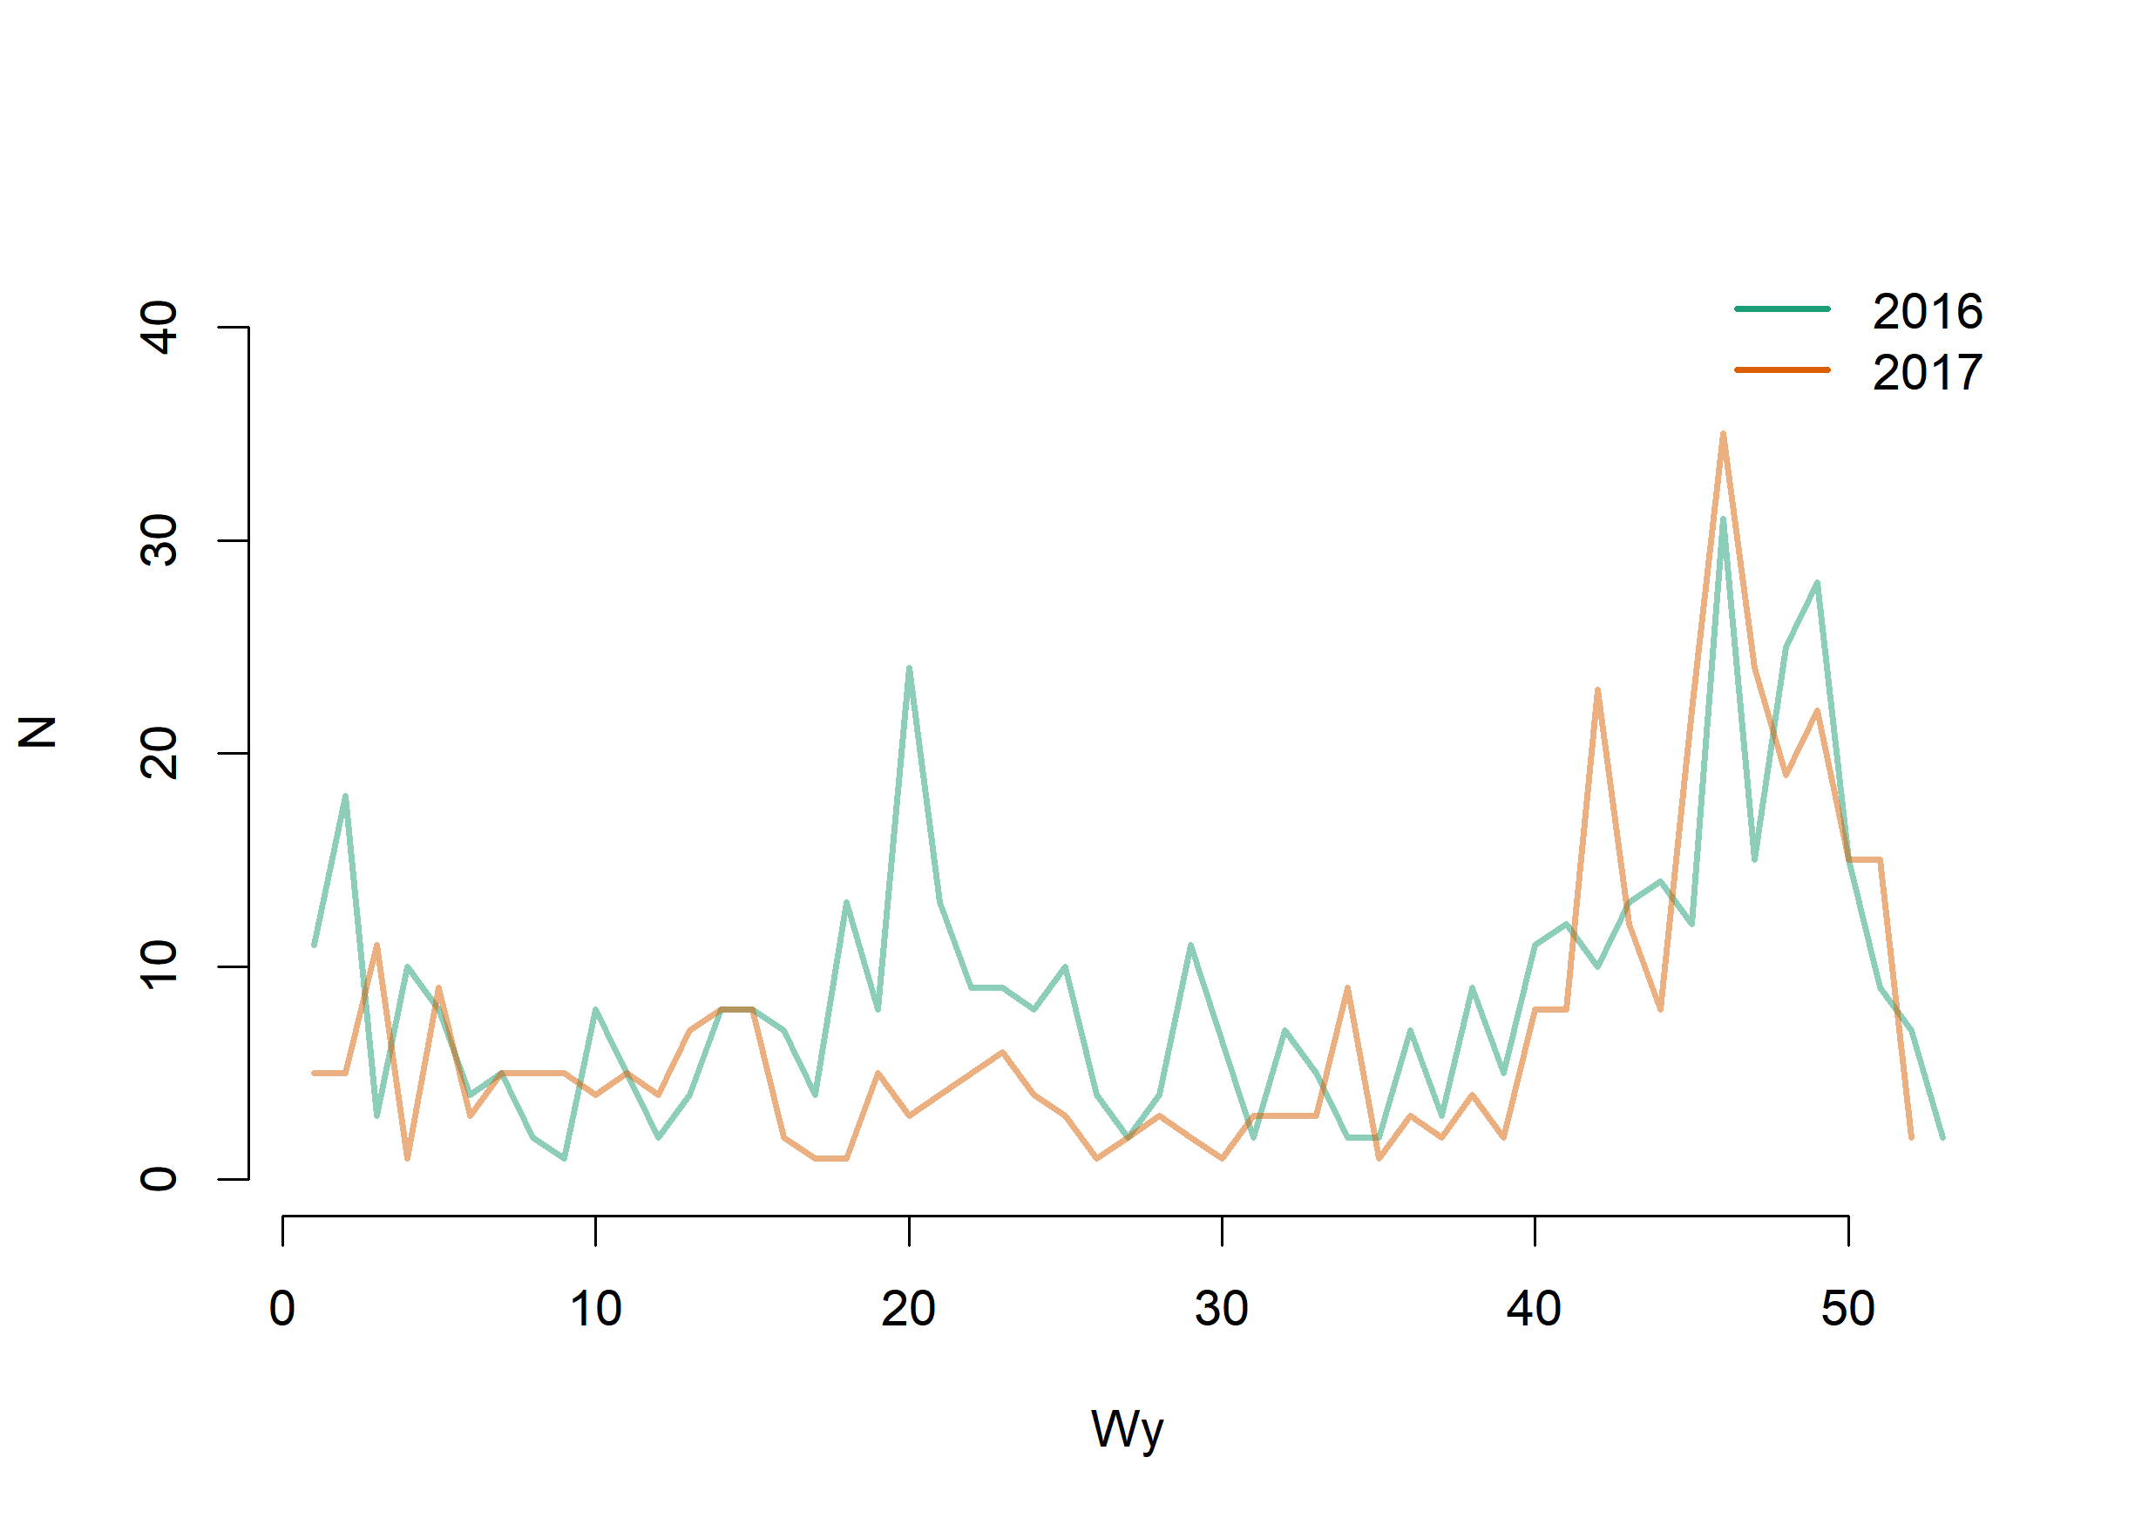
Disease spread models
S
I
R
3
10
S
I
R
5
S
I
R
S
I
R
2
6
4
S
I
R
S
I
R
Notes:
One approach to deal with heterogeneity of the population is using metapopulation models, where we stratify the population according to some characteristics.
We can include a network to inform our model with the rates of contacts between populations
For this like we mentioned previously, you require network data that is representative and likely to reproduce in the future

Slide 31
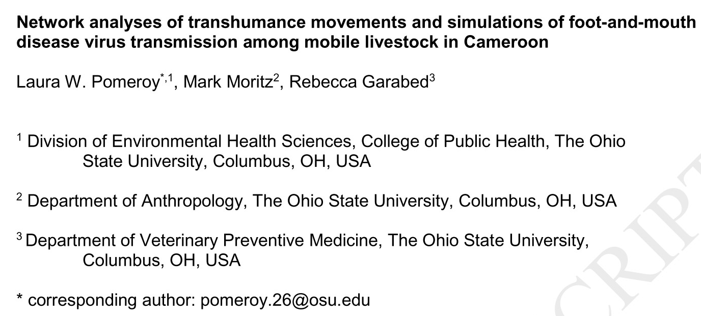



Disease spread models
Using R:
Statnet
siminf
Using Agent-based models:
http://contagion.principate.org/
GAMA Platform
NetLogo
https://gama-platform.github.io/wiki/Home
https://ccl.northwestern.edu/netlogo/

Slide 32
Questions?

